Slide 1
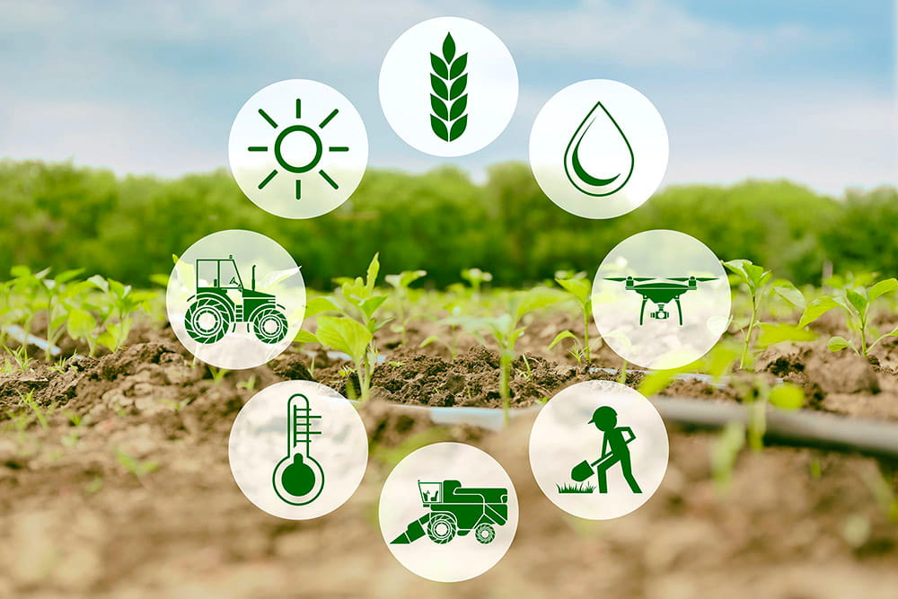
Presented By Goutam Kuiri

Slide 2

India’s Agricultural Crop Production Data Analysis
Data Collection
Crop Production Data provide through the Unified Mentor Pvt.Ltd
Crop Production data.csv Format
Total 246091 entries means row
Total Columns 7
Four columns are categorical data
Three columns are numerical data
Good Afternoon, Today I am presenting my analysis on India’s Crop Production. India is an agricultural country . Which helps to contribute about Agriculture: 18.4% Industry: 28.3% Services: 53.3% (FY 2021–22). While doing this analysis the first question in mind my was is India producing enough to feed its population?

Slide 3
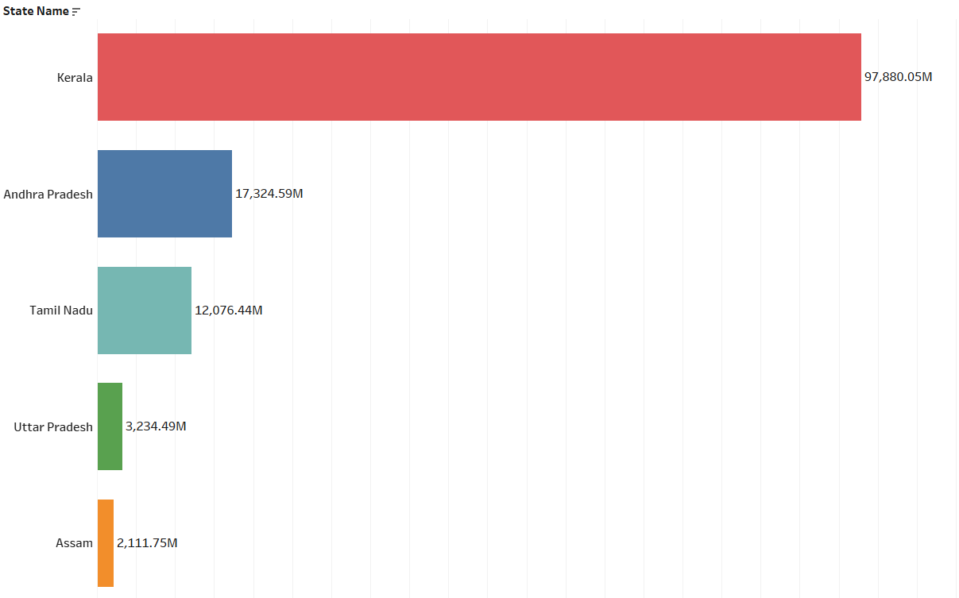

Highest crop producing states (1997 - 2019)
This graph represents crops highly produced from 1997-2015. Sugarcane, Rice, Wheat cotton and maize are the most produced ones. Kerala and Andhra Pradesh this two states is more crop producing states only this two states 115.2B tons Crop Production in india .

Slide 4
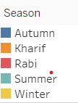
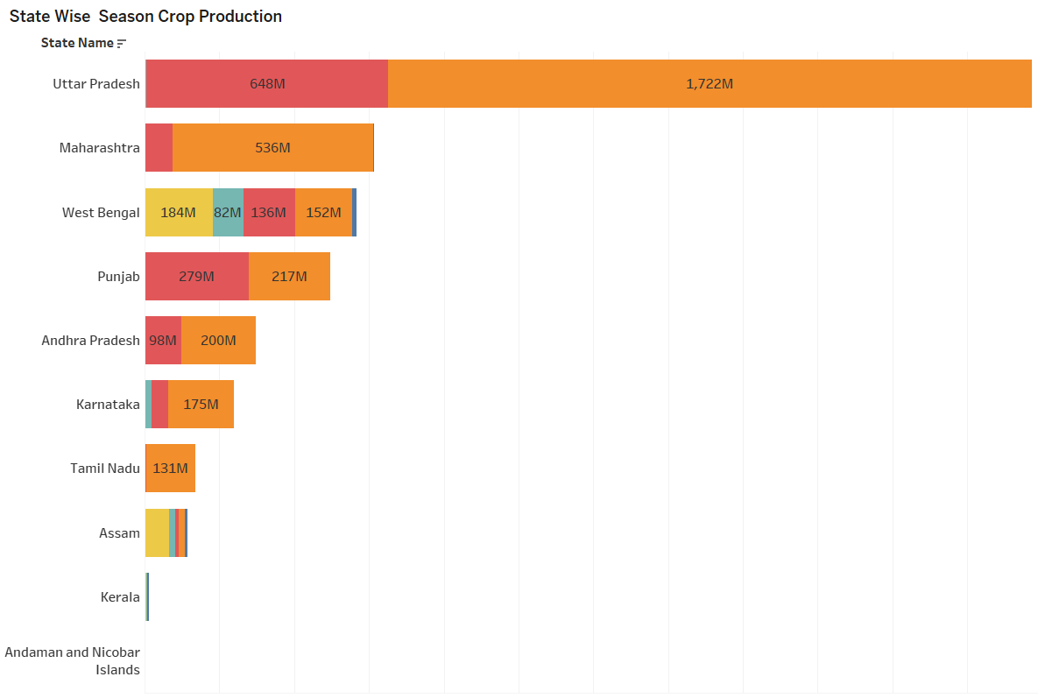
State Wise Season Crop Production
Uttar Pradesh:
Major crops: Wheat, rice, sugarcane, potatoes.
Uttar Pradesh is one of the largest producers of wheat and sugarcane in India.
Rabi season this two crops production is high Wheat (469.91M) and Potato(129.60M) tons etc.
Kharif Season this two crops production is high in this seasons Sugarcane(1408.30M) and Rice(218.12M) tons etc.
Such types are other states information available in this dashboard to helpful for take business decisions.

Slide 5

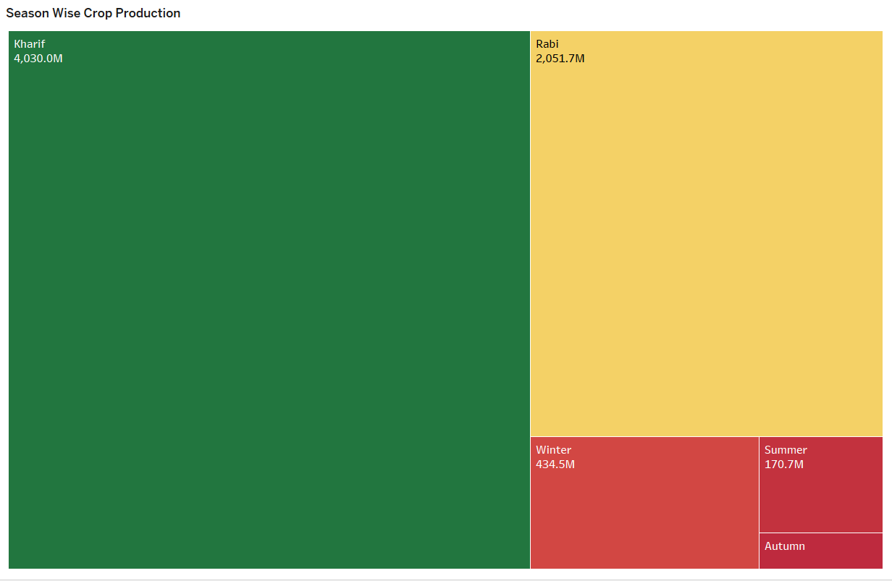
Season Wise Crop Production
Kharif Season highest crops production 4030.0M and Autumn is the lowest crop production 64.4M in india .

Slide 6

THANK YOU

